Slide 1

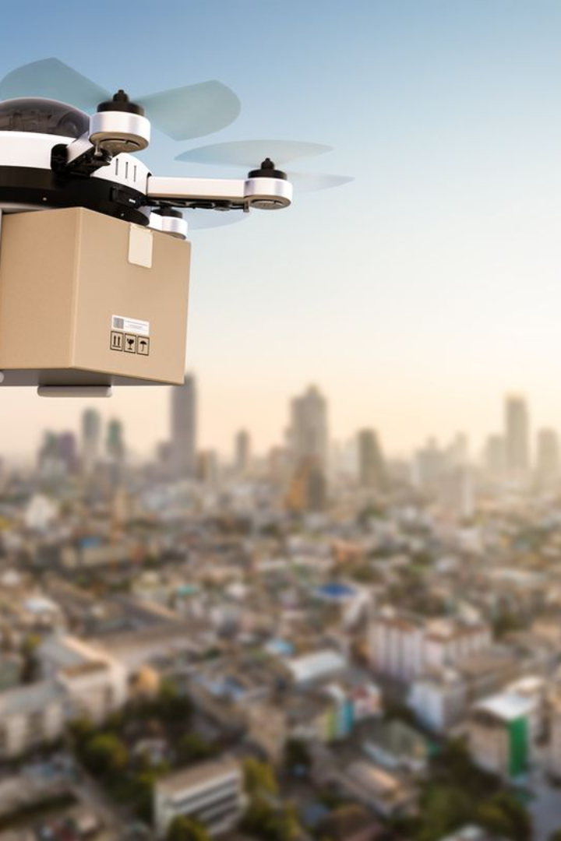
Introduction to AI Fusion
AI Fusion is a cutting-edge solution that combines artificial intelligence with drone technology to deliver medical supplies to remote and war-hit areas.

Slide 2
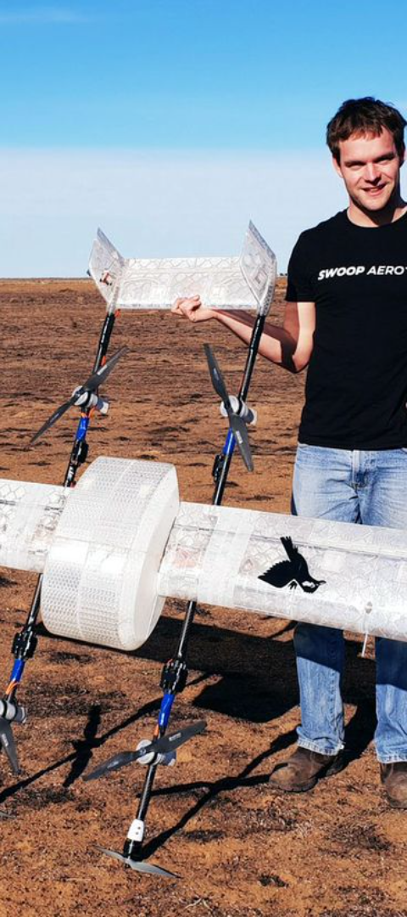
Importance of Drone Delivery
1
Accessibility
Enables access to areas with poor infrastructure.
2
Speed
Provides rapid delivery of critical medical supplies.
3
Safety
Reduces the risk for human delivery personnel.

Slide 3
Challenges in Medical Supply Delivery
1
Infrastructure
2
Conflict Zones
Lack of proper roads and transportation systems.
High-risk areas with security and safety challenges.
3
Weather Conditions
Extreme weather affecting traditional delivery methods.

Slide 4
Terrain Mapping and Obstacle Detection:
LiDAR:
Employ 3D LiDAR sensors to create high-resolution point clouds of the environment, accurately capturing terrain changes, debris, and vegetation.
Develop algorithms to segment the point cloud and identify obstacles like buildings, power lines, and unexploded ordnance (UXO).
Computer Vision:
Utilize high-resolution cameras capturing real-time video feeds.
Train deep learning models like convolutional neural networks (CNNs) to recognize specific obstacles in war zones, such as damaged infrastructure, craters, and camouflaged objects.
Fuse LiDAR and camera data for more robust obstacle detection, leveraging the strengths of each modality.

Slide 5
Terrain Mapping and Obstacle Detection:
Path Planning and Dynamic Navigation:
Path Planning:
Employ algorithms like A* search or rapidly exploring Random Tree (RRT) to plan safe and efficient routes based on the LiDAR map and obstacle detections.
Dynamic Navigation:
Use real-time LiDAR and camera data to continuously update the map and adapt the flight path in response to unexpected obstacles or changes in the environment.
Implement reinforcement learning techniques where the drone learns through trial and error to navigate complex and dynamic environments.
Additional Considerations:
Safety and Reliability:
Design the system with redundancy and fail-safe mechanisms to handle sensor failures or unexpected events.
Implement collision avoidance protocols and emergency landing procedures.
Communication and Control:
Develop secure and reliable communication links between the drone, control stations, and cloud-based AI processing systems.
Consider using satellite connections or mesh networks in areas with limited infrastructure.

Slide 6
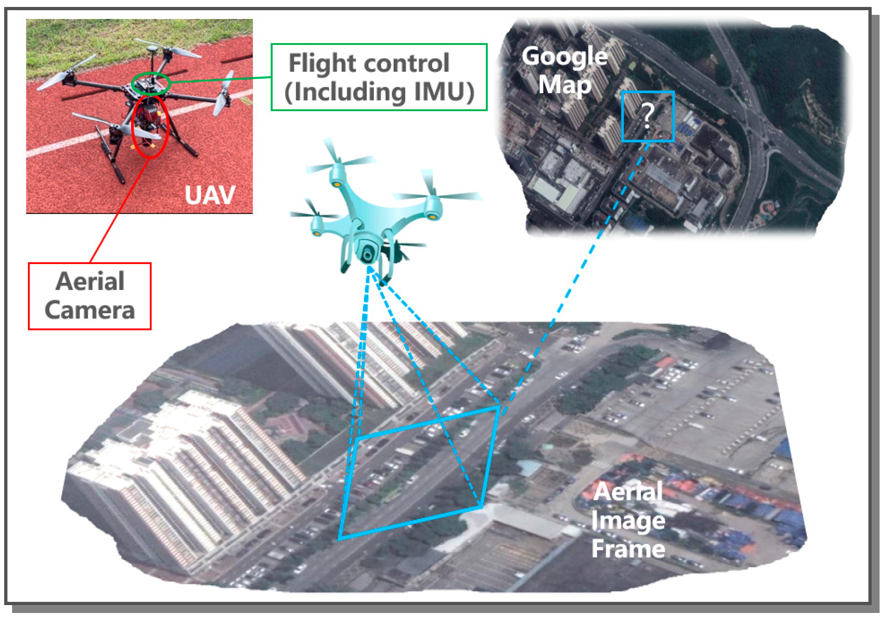

Slide 7

Revolutionizing Drone Delivery
Autonomy
Precision
Adaptability
AI-powered drones capable of independent navigation.
Accurate delivery to specific GPS coordinates.
Ability to adjust routes based on real-time data.

Slide 8




Key Features of AI Fusion Drone
Autonomy
Precision
Adaptability
Speed
Independent navigation ability.
Accurate delivery to GPS coordinates.
Adjusts routes based on real-time data.
Rapid and efficient delivery times.

Slide 9
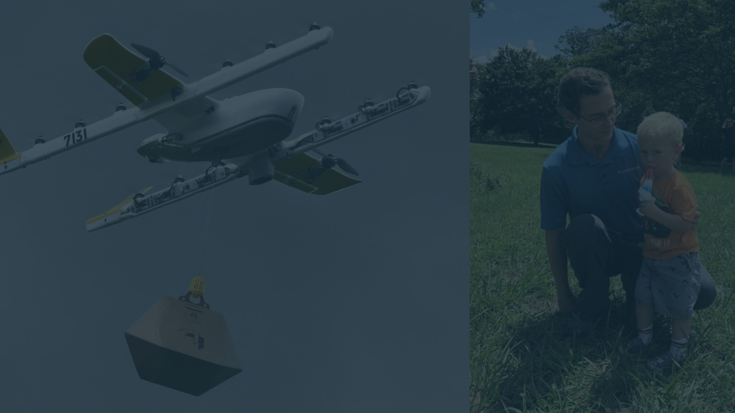



Successful Case Studies
Madagascar
Rwanda
Papua New Guinea
Saving lives through timely medicine supply.
Efficient delivery to remote mountainous regions.
Overcoming geographic barriers for medical supply.

Slide 10
Benefits of AI Fusion
Efficiency
Lifesaving
Sustainability
Reduces delivery time and costs.
Provides critical medical aid promptly.
Minimizes carbon footprint from traditional transport.
Improves supply chain logistics.
Enhances emergency response capabilities.
Supports eco-friendly delivery systems.

Slide 11
Conclusion & Future Prospects
75%
30%
Reduction in Delivery Time
Cost Savings
Compared to conventional delivery methods.
Due to efficient routing and autonomy.

